Slide 1
Hybrid Encryption Technique To Fortify Caesar Cipher
Team Details
P Neetha Reddy(20eg105435)
M Surya Teja(20eg105423)
Project Supervisor
B. Ravinder Reddy

Slide 2
Introduction
The “ Hybrid Encryption Technique To Fortify Caesar Cipher ” project is a combination of Caesar Cipher and RSA Algorithm.
It helps the confidential information to be protected and the data transmitted is safeguarded.
With the encryption of the message using caesar cipher and ensuring further layer of security with RSA encryption, this project offers a great level of security against any kind of interceptions.

Slide 3
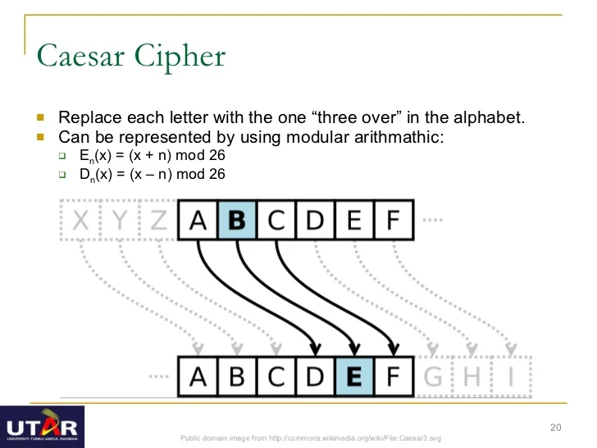
Caesar Cipher

Slide 4
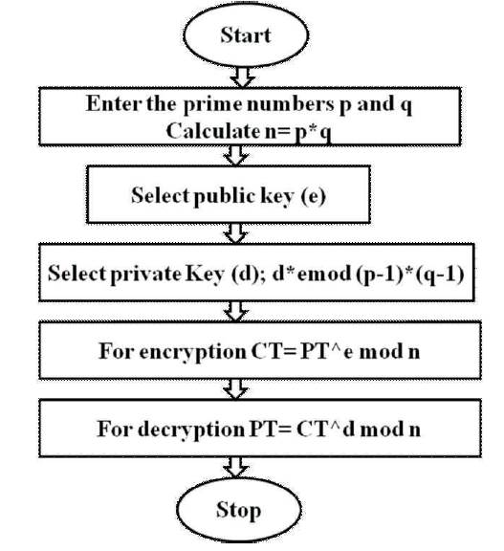
RSA

Slide 5
Literature
Author(s) | Method | Advantages | Disadvantages
Benna Purnama, Hetty Rohayani.AH | A Modified Caesar Cipher Cryptology Method With Legible Ciphertext | Increases the complexity of the encryption process | Vulnerable to Brute force attack, Frequency analysis attack
A.Rajan, D.Balakumaran | Advancement In Caesar Cipher By Randomization And Delta Formation | Security against brute force attack and differential attack | Vulnerable to Frequency analysis attack
Fahad Naim Nife | New Modified Caesar Cipher Cryptographic Method Along With Rail Fence To Encrypt. | Secure against differential attack | Vulnerable to Frequency analysis attack, Brute Force attack
Lavanya K.Galla, Venkata Sree Krishna Koganti, Nagarjuna Nuthalapati | Implementation Of RSA | Security against brute force | Vulnerable to Factorisation attack
P.M.Durai Raj Vincent | RSA Encryption Algorithm - A Survey On Its Various Forms and Its Security Level | Improves the security against the frequency analysis attack. | Performance is compromised when the key size is large

Slide 6
Problem Statement
Caesar cipher is one among the well known algorithm in cryptography but it is vulnerable to Brute force attack, Frequency analysis attack, Dictionary attack, etc. Many modern cryptographic algorithms have suggested improvement for caesar cipher but still failed to make it strong enough against attacks.
Department of Computer Science and Engineering

Slide 7
Objective
The solution for the above problem is the proposed method - “To design and implement hybrid model of Caesar cipher and RSA by encrypting the message twice, once with caesar cipher then followed by RSA for securing the message.”
The parameters which are considered for the project evaluation are :- Encryption time Decryption time

Slide 8
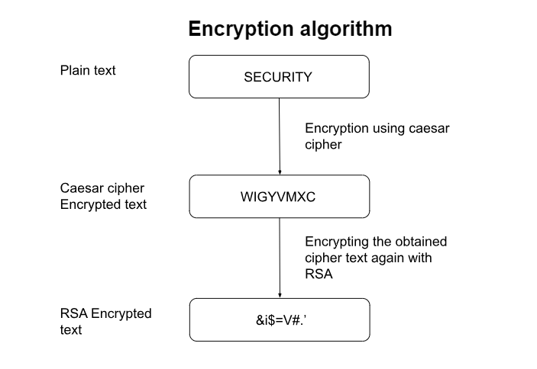
Proposed Method

Slide 9
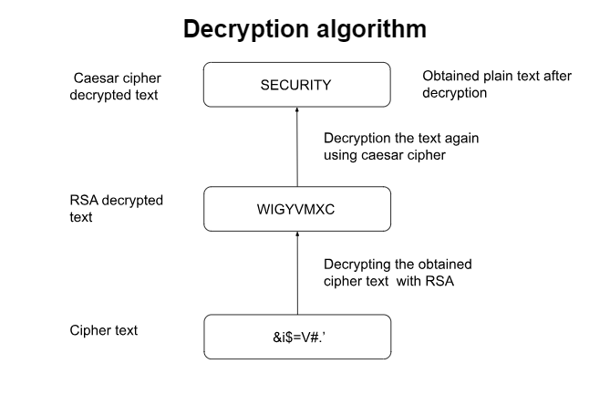
Proposed Method

Slide 10
Project status
S.No | Functionality | Status (Completed /in-progress/Not started)
1. | Plaintext and Key input | Completed
2. | Key generation for caesar cipher | Completed
3. | Encrypt using Caesar cipher | Completed
4. | Key generation for RSA | In Progress
5. | Encrypt using RSA | In progress
6. | Decrypt using RSA | Not Started
7. | Decrypt using Caesar cipher | Not Started
8. | Error handling and management | Not Started
9. | Display output | Not Started

Slide 11
References
IEEE paper - Innovative enhancement of caesar cipher algorithm for cryptography
( URL - https://ieeexplore.ieee.org/document/7749010 )
IEEE paper - Advancement in caesar cipher by randomization and delta formation.
( URL - https://ieeexplore.ieee.org/abstract/document/7033998 )
RSA Encryption Algorithm - A survey of various forms and its security level
( URL - https://www.researchgate.net/publication/306215546)

